Slide 2
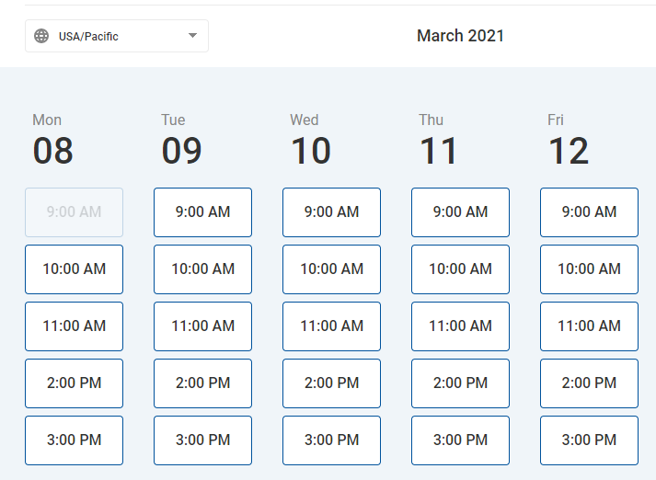
The SCCAOR Office is now open for limited in-person appointments at both our San Jose and Gilroy locations
www.sccaor.com/appointment

Slide 9
See all upcoming events and classes
www.sccaor.com/calendar
Watch recordings of past webinars
www.sccaor.com/edu/webinars

