Slide 1
Serving the Many Faces of Silicon Valley
Presented by
Adria Quinones-Masur
Director, Homebuyer Programs

Slide 2
What is the Housing trust?
Since 2000…
$183 Million
Invested in affordable housing
16,977 housing opportunities
30,633 people helped
3.1 billion
leveraged by our partners

Slide 3
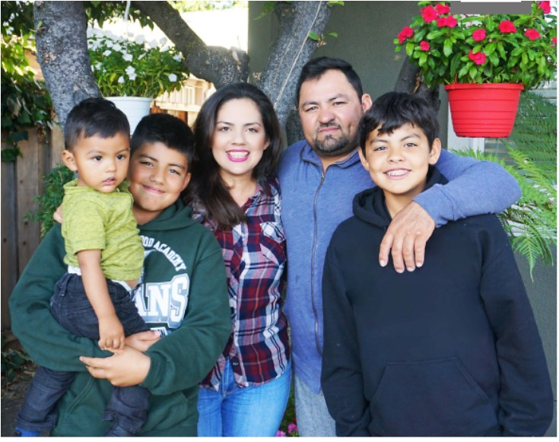
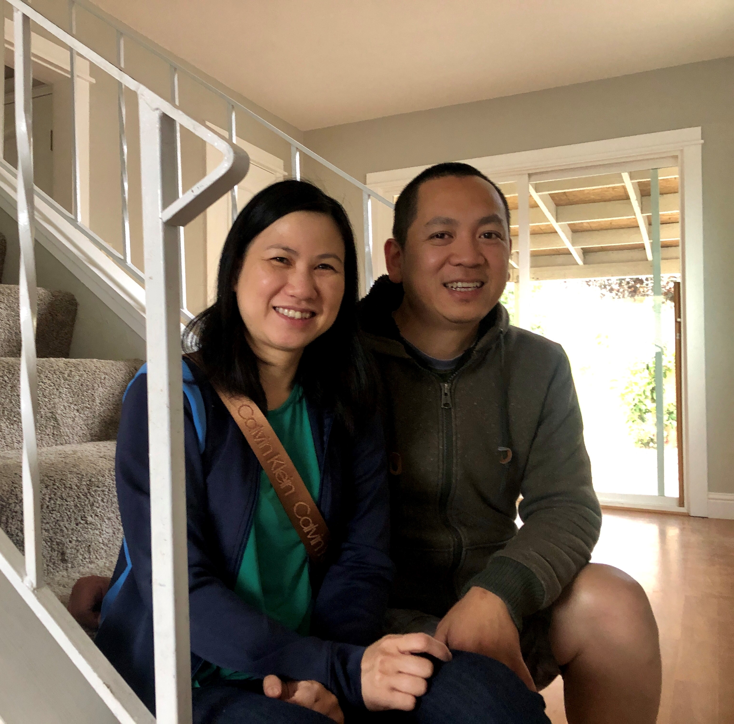
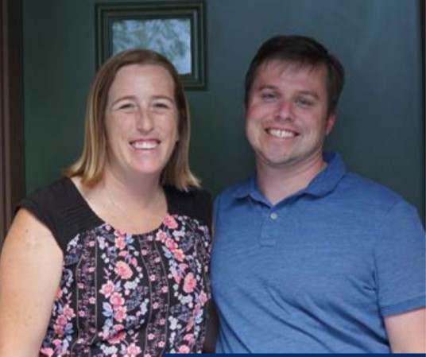
First time homebuyer programs

Slide 4
WHO are we serving
Population – Santa Clara County
1.9 million residents- largest in the region
Santa Clara is growing — its population is up 9.9 percent from 2010.
Race
Asians - 35 percent
Whites - 33 percent
Hispanics- 26 percent
Blacks -3.1 percent
52 percent speak a language other than English at home.
Notes:
Population
According to an article in the Mercury News “Santa Clara County’s 1.9 million residents make it the largest in the region, beating out second ranked Alameda County by about 300,000 people. And Santa Clara is growing — its population is up 9.9 percent from 2010.
Race
Asians make up 35 percent of Santa Clara County’s population, edging out whites who make up 33 percent. The county also has the largest Hispanic population of the four, at 26 percent. Blacks are at 3.1 percent
Foreign born
Not surprisingly, Santa Clara also has the highest share of residents 5 years and older who speak a language other than English at home. At 52 percent, that’s higher than California’s overall 44 percent. Asian and Pacific Island languages are the most common, other than English, at 24 percent, followed by Spanish at 18 percent.

Slide 5
the obstacles are…
Saving enough money for a down payment and closing costs- 77%
Lack of credit history - 63%
Lack of knowledge of the homebuying process- 63%
Not knowing someone to guide them through the homebuying process - 59%
Not having access to mortgage forms and other paperwork in their native language - 36%

Slide 6
California association of realtors 2018
“The most obvious reason Americans are lacking key information is because buying a home is an infrequent transaction.”
Doug Duncan
Chief Economist, Fannie Mae.

Slide 7
WHAT CAN YOU DO?
Embrace Becoming a Guide
Expand Your Knowledge
Develop Partnerships
Offer More

